Slide 1

Double Helix
A Project by Tommy Ngan

Slide 2

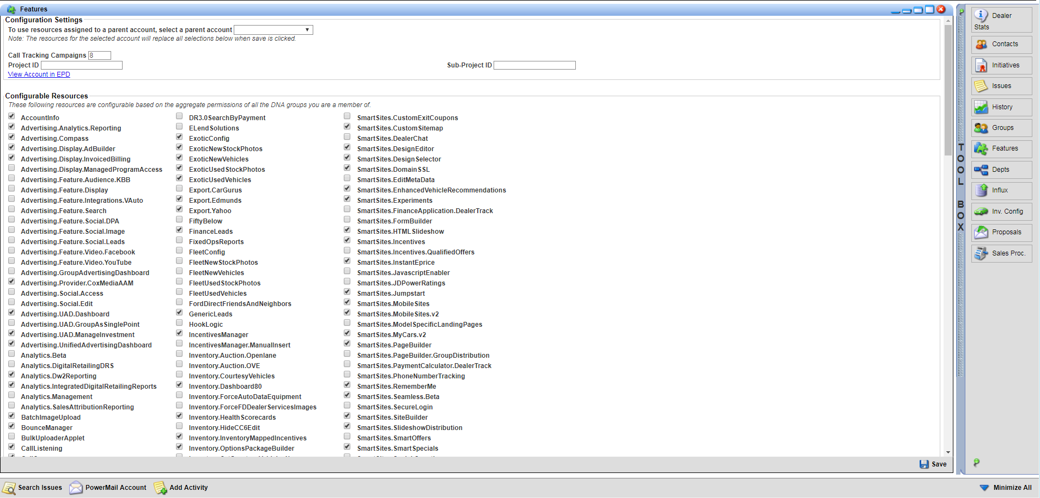
Current Process

Slide 3

Finding Answers
Fuel Space
PSS Chatroom
DM Neighbors
Uninvited Visits

Slide 4
Welcome Double Helix
Lists all DNA Features with relatable Fuel Pages (ongoing)
Lists every Control Center Product with relatable Fuel Pages and required DNA Feature(s)
Lists every product available for each Brand
Lists every product available based on Website Package

Slide 5

Database Management
Managed in Google Sheets
Access has been given to PSS team
Changes made in the database are pretty instantaneous to the webapp, however you do need to refresh the page

Slide 6

Current Known Issues and Future Releases
The database is not very easy to navigate, so it would be ideal to move from Google Sheets to SQL with a UI
Integrate Lazy Loading (it’s very slow to load)
Mobile friendly
Free form search (you can do a CTRL+F right now)
Possible DNA Replacement?

Slide 7
CONGRATULATORY SLIDE
Randy Humphrey
Cody Duquette
Paddy Rafferty
Sabrina Fitzgerald
Gary Peters
Henry Latour
Rama Kocherlakota
Tabare Gowon
PSS Team
PQA Team

